Slide 1





MusicListify Data Science for good taste of music
Buğrahan Eroğlu 30631

Slide 2

THE EFFECT OF MUSIC TASTE ON A PERSON
People’s music taste reveal information about their personality, daily life and academic life.

Slide 3

My Motivation
My main purpose and motivation is to understand whether listening music is beneficial for my life.
z

Slide 4

MY HYPOTHESIS
Music has a impact on people’s daily lives and impact on their academic lives.

Slide 5

MY DATASET SOURCES
My personal data summary from Spotify which is mobile application for music.

Slide 6
Process
Topic Selection
Data Collection
Data Cleaning
Data Visualization
Tables, Graphs, Explanations
Hypothesis Testing

Slide 7
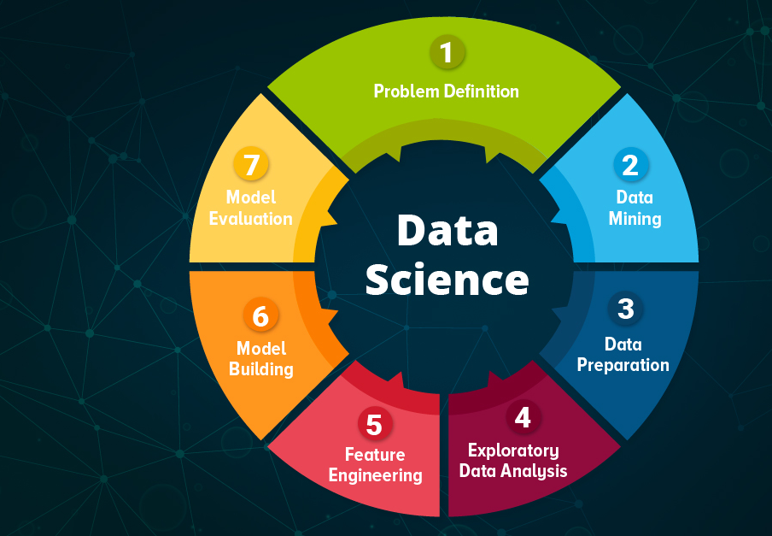
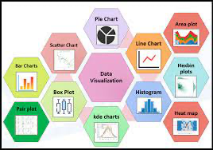
TECHNIQUES
Data Processing
Excel Processing
Data Transformation
Data Visualization
Pie Chart
Graph display
Data filtering

Slide 8
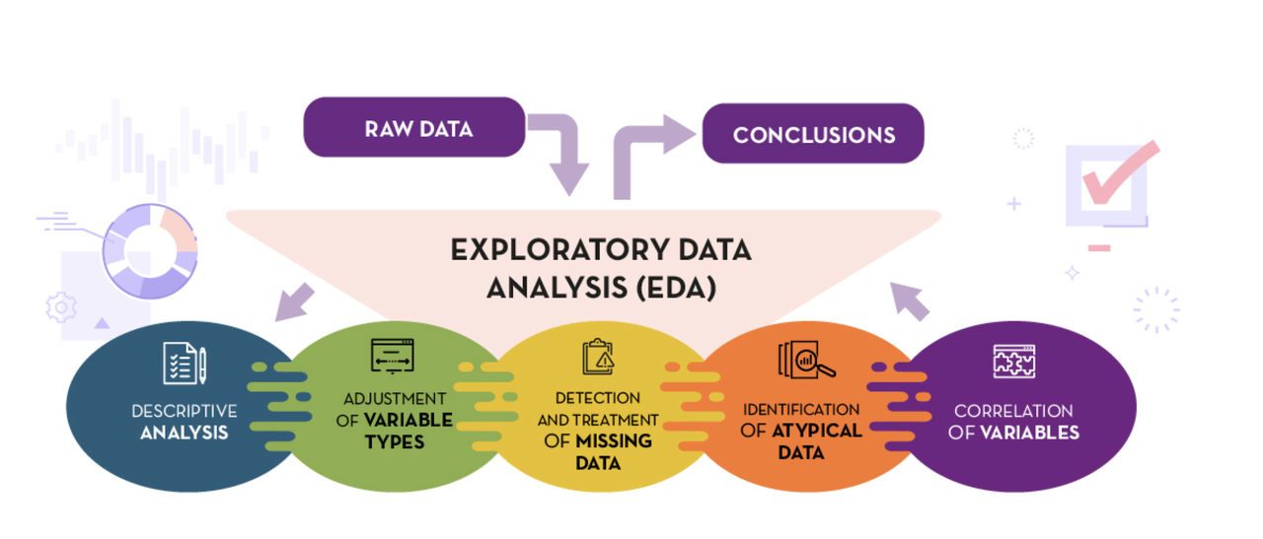
EDA
z
exploratory data analysis

Slide 9
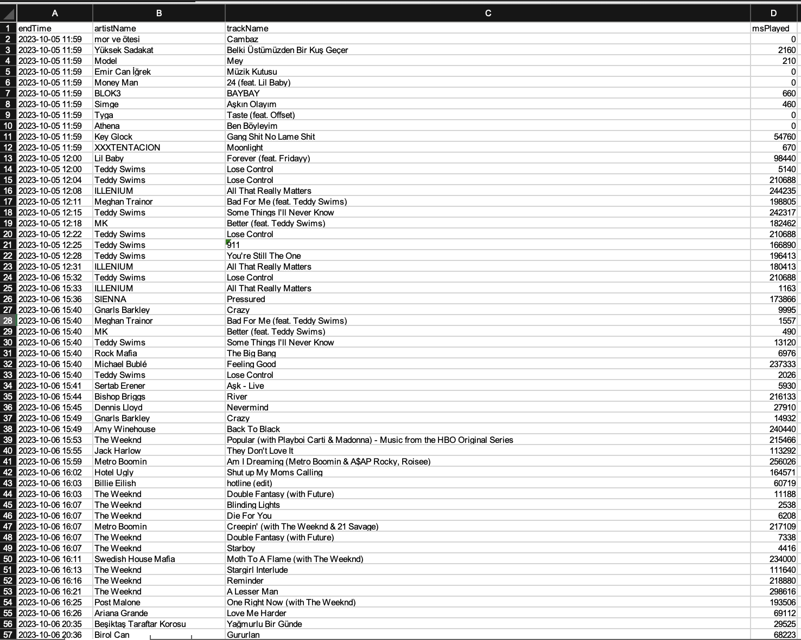

Excel Processing

Slide 10
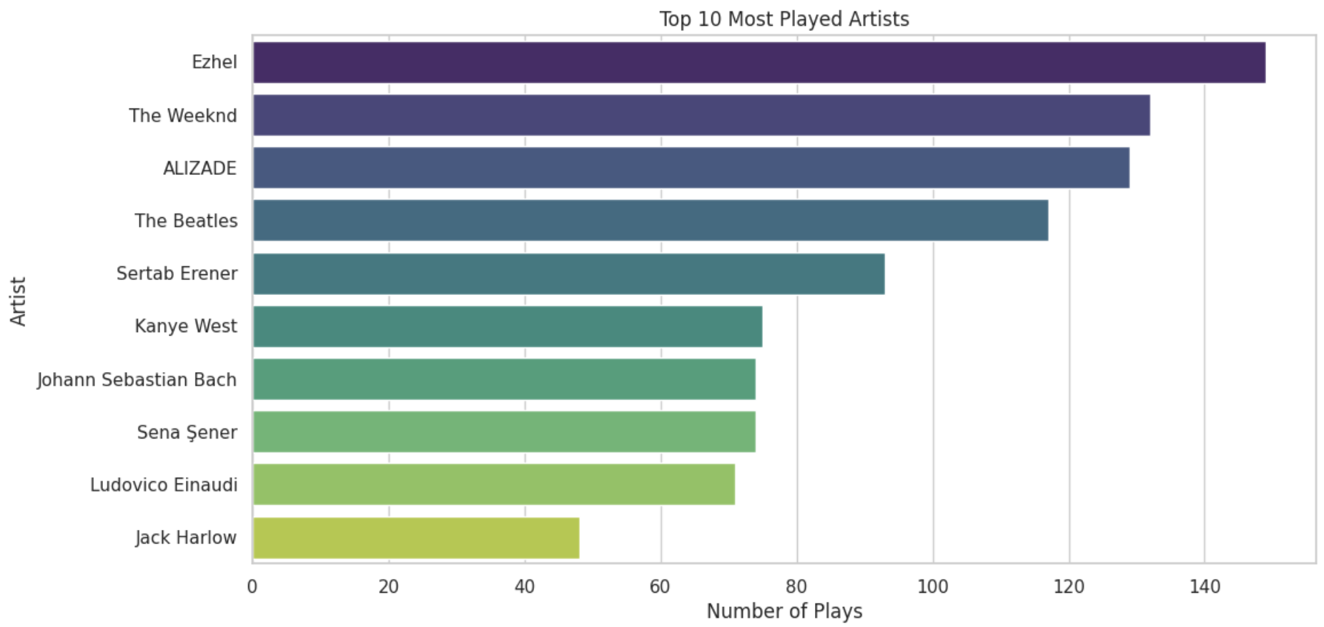
Data Visualization

Slide 11
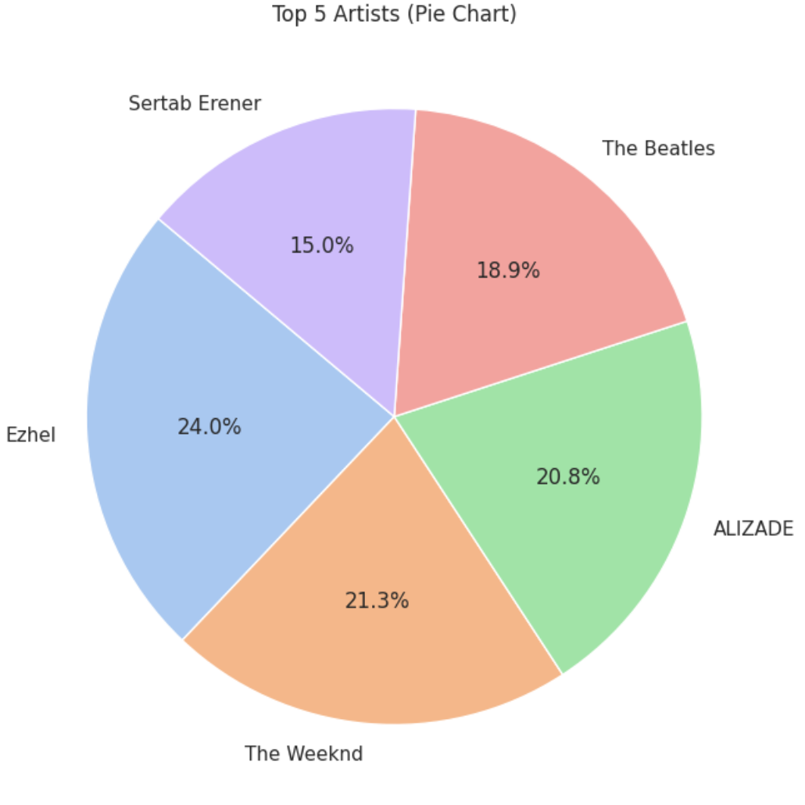
Pie chart
z

Slide 12
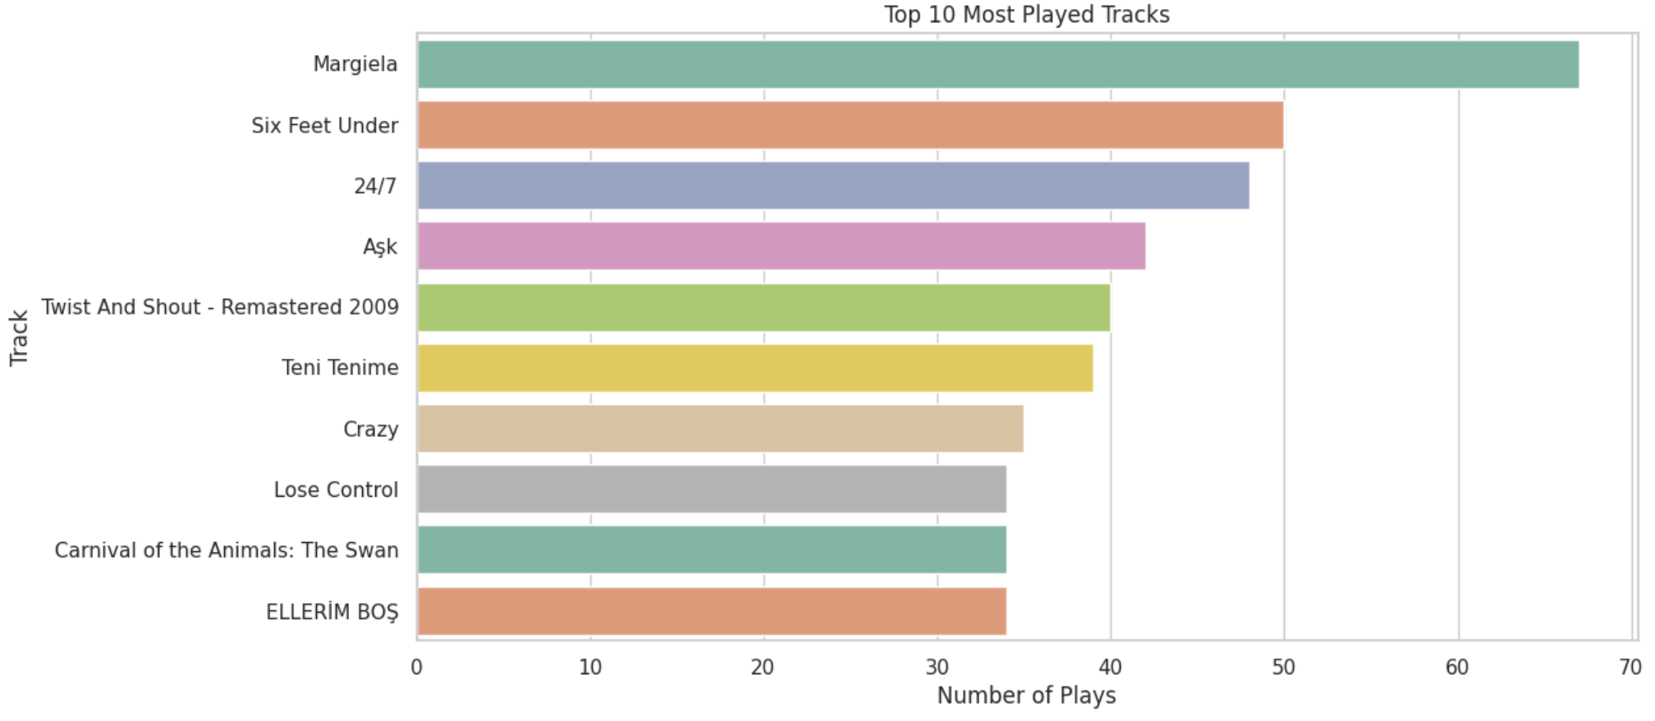
Bar chart
z

Slide 13
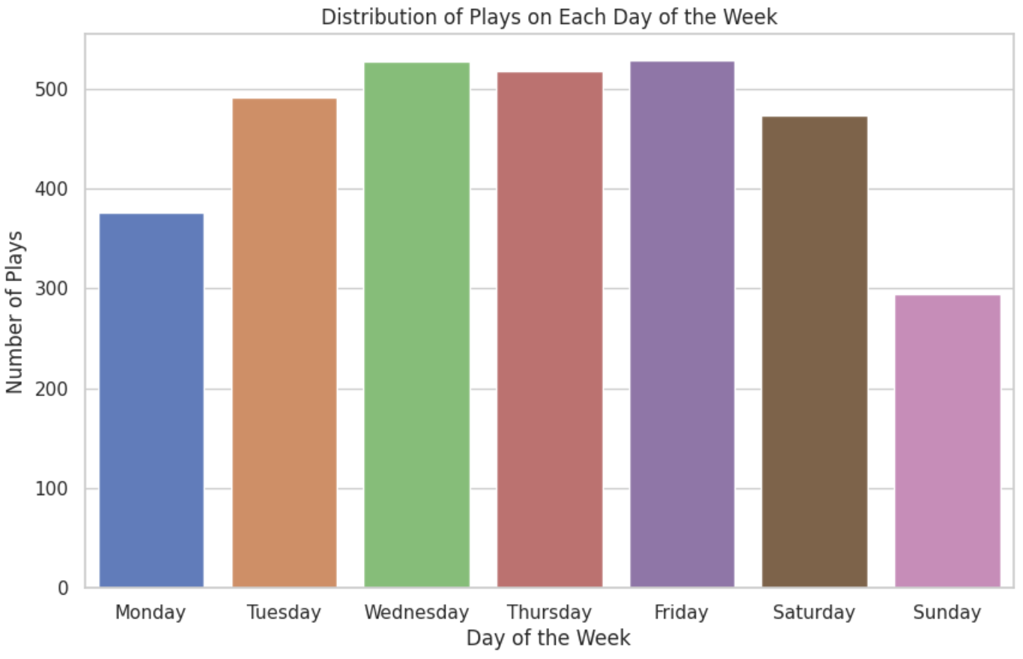

Slide 14
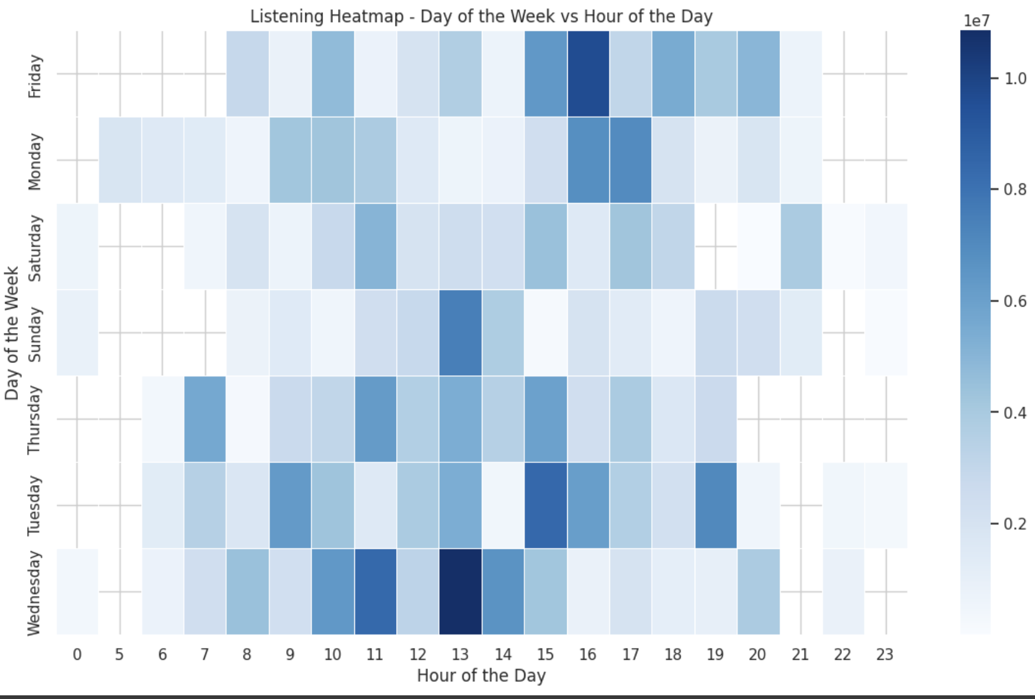
Heatmap

Slide 15
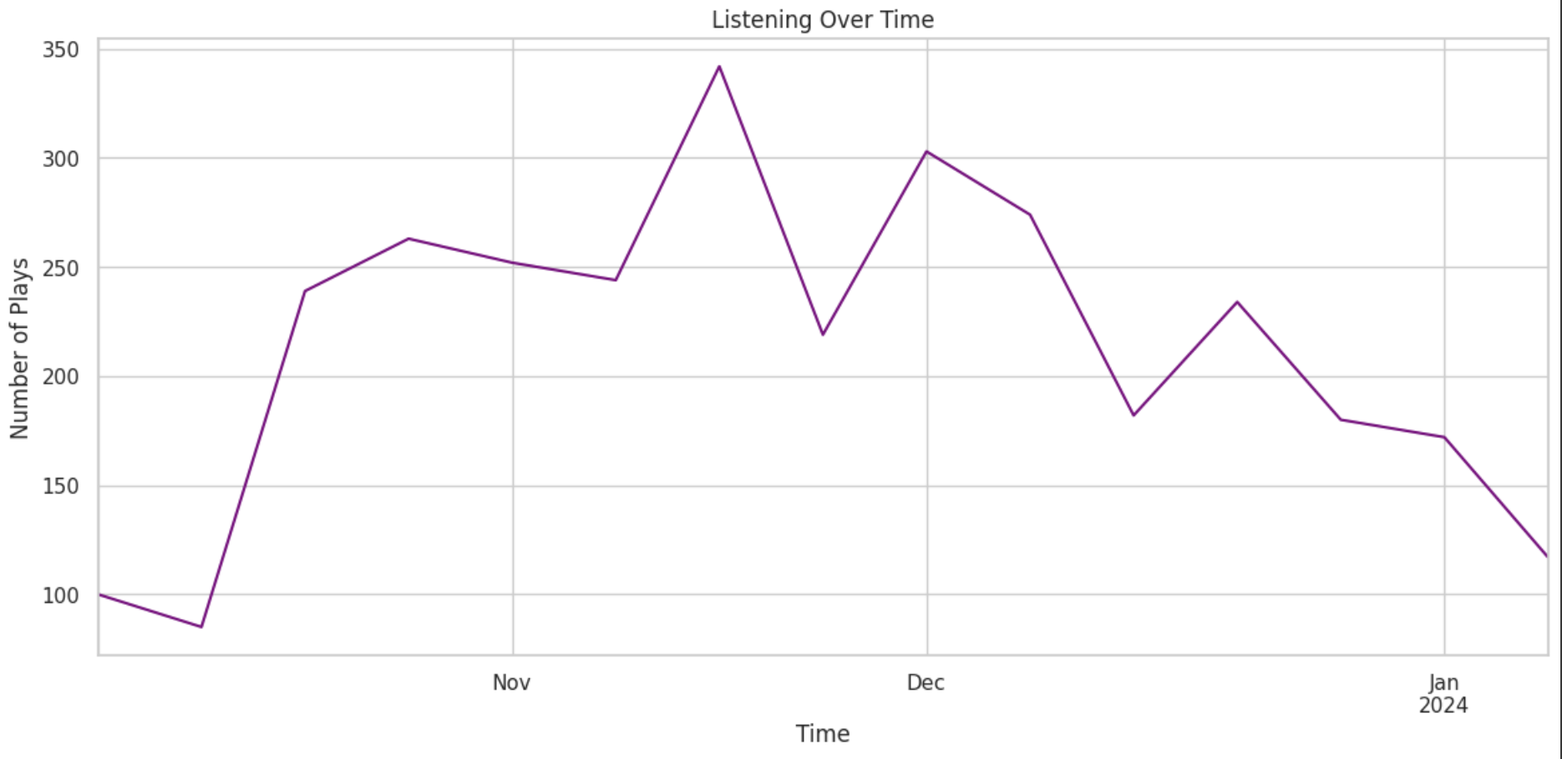

Slide 16
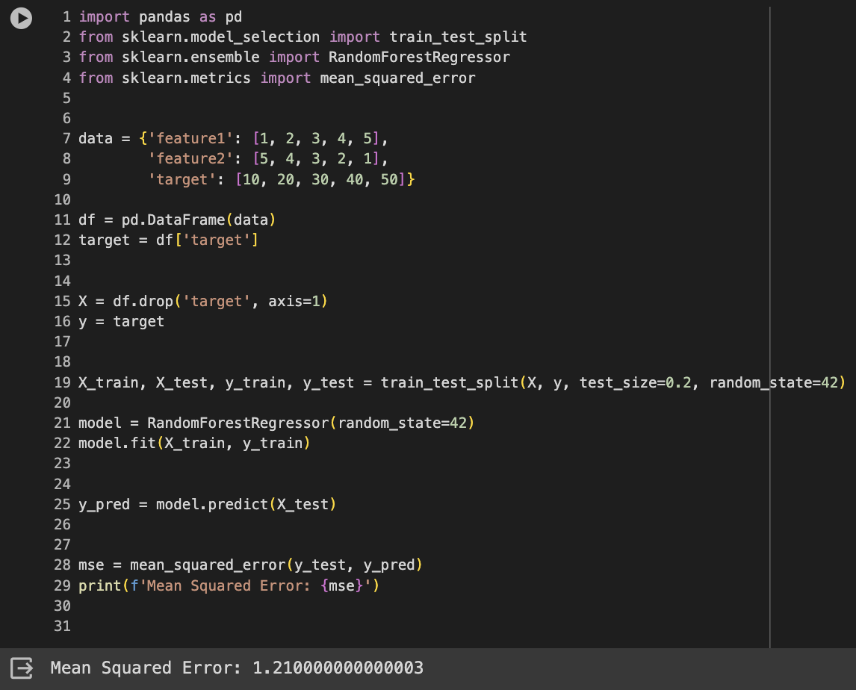
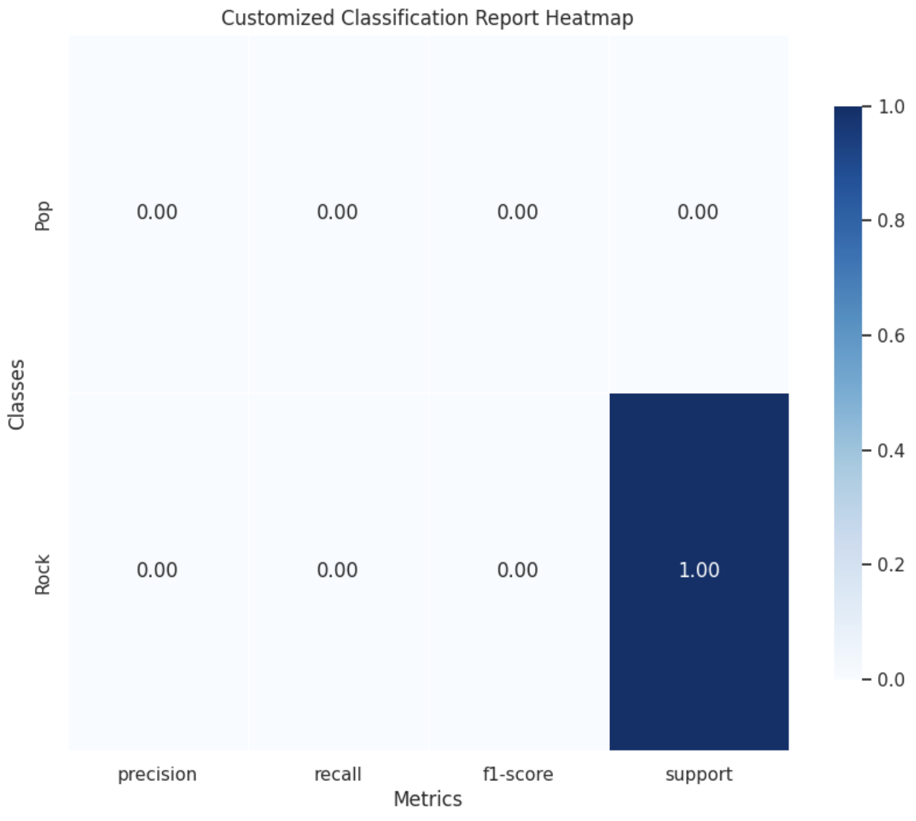
Machine Learning Model

Slide 17
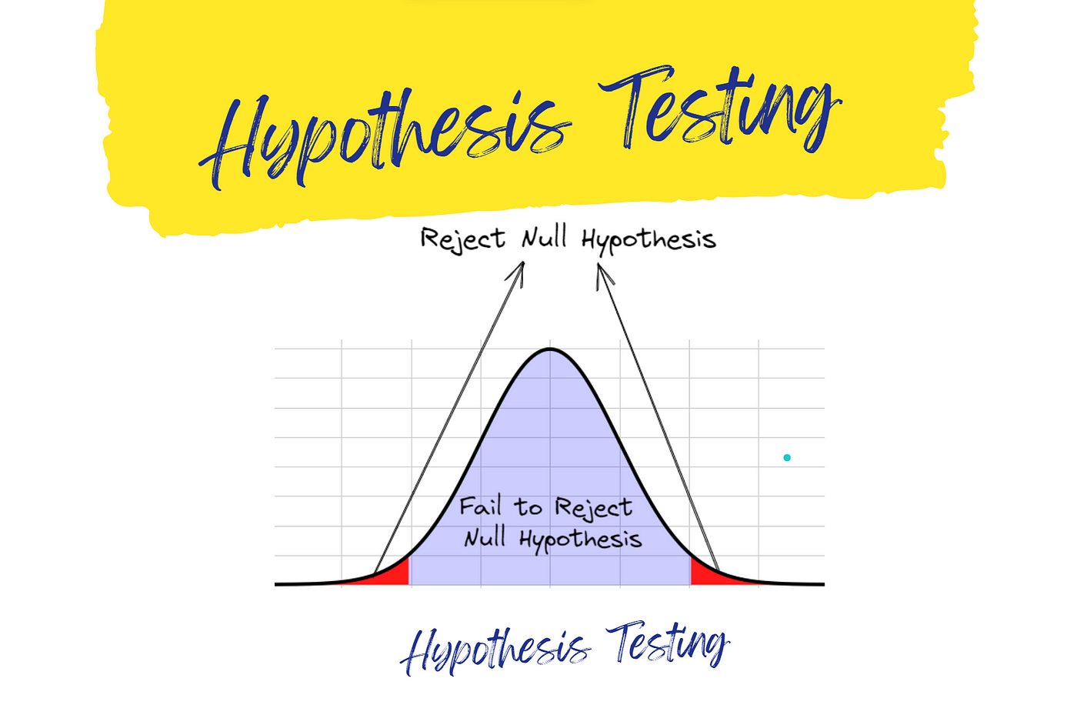
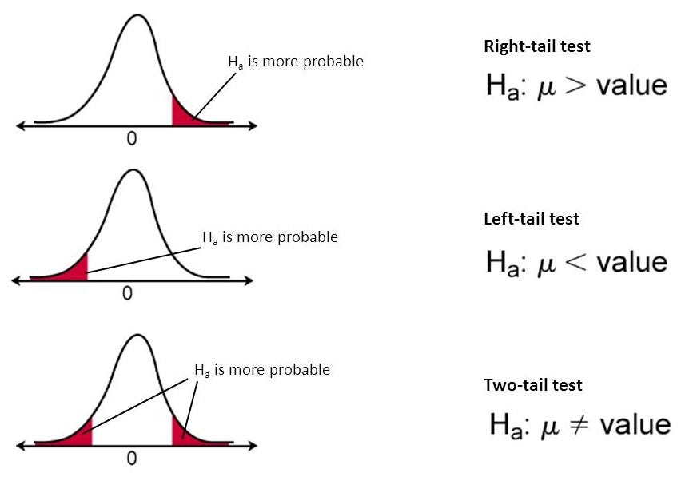
Hypothesis Testing
Null Hypothesis: Listening to music does not affect a person's daily life or academic life. It's all by chance.
Alternative Hypothesis: Listening to music directly affects a person's daily life and academic life.

